Slide 1
LangVRse
Immerse Yourself Beyond What You Know

Slide 2
01
PROBLEM/SOLUTION

Slide 3
Problem/Solution Overview
Problem: Immersive Language Learning Experiences do not focus on social & cultural aspects of a language.
Our solution will prepare language learners for everyday life scenarios.
Our solution will be conscious of the cultural implications of misrepresenting a language’s origin and traditional practices.
Our solution will be challenging enough for learners but comfortable enough to encourage engagement.

Slide 4
02
MARKET RESEARCH

Slide 5





Market Research Value Proposition
Mondly VR
Wander
"Travel the world and learn new languages"
"Wander the world openly through the magic of VR"
Google Expeditions
Duolingo
Quizlet
"The free, fun, and effective way to learn a language!"
"The fun, fast-paced classroom learning that students love"
"Take a virtual field trip"

Slide 6
Market Research Problem/Solution Overview Pt. 1
Mondly VR
  How Solution Differs: VR-focused business trips and everyday experiences. No emphasis on culture.
  What Has Worked: VR immersion experience.
  What Hasn’t Worked: Repetition-centered, not comprehension.
Wander
  How Solution Differs: Exploration-centered, but no language-learning component.
  What Has Worked: Historical perspective feature very effective for capturing community history.
  What Hasn’t Worked: Platform not intended for language immersion.
Duolingo
  How Solution Differs: Popular language learning app, but has no VR/AR component.
  What Has Worked: Vocabulary focused.
  What Hasn’t Worked: Does not help people develop conversational skills.

Slide 7
Market Research Problem/Solution Overview Pt. 2
Quizlet
  How Solution Differs: Focuses on flash cards and games as a form of learning and repetition.
  What Has Worked: Allows for friendly competition and collaboration with others when creating flash card sets.
  What Hasn’t Worked: Mostly vocabulary focused, doesn’t allow for student to apply words in context.
Google Expedition
  How Solution Differs: Focused on short lessons about a range of topics, rather than a progression of learning a specific topic.
  What Has Worked: Very good tools, with slow speed so users can process the information, support for low bandwidth, and other nice components.
  What Hasn’t Worked: Doesn’t have many user-interactive components (can look around the location/items), but can’t make your own choices.

Slide 8
How Our Solution Differs
More user-controlled learning pace
Focus is not strictly on building a big vocabulary base, but rather practicing fluency with reading, writing, and comprehension using those basic vocabularies
Practical day-to-day traveling activities where nearly all users can access or experience something similar (e.g. ordering an item at a store, requesting a ride) rather than a flight to the country where only a few can have that immediate experience

Slide 9
03
TASKS

Slide 10

TASKS
Simple
Moderate
Complex
Understand simple phrases in a language of interest
Be able to answer questions and follow instructions
Understand the customs of the people
who speak this language
Hold a full conversation in a language of interest
Apply new phrases in a language of interest
Be able to read and write common statements

Slide 11
04
VALUES IN DESIGN

Slide 12
Values in Design
One of our main values is respect, particularly respecting the culture and people behind the languages we hope to integrate in the app.
In designing this app, we also hope to make it accessible to all (people from all socioeconomic, racial, visible and hidden (dis)ability backgrounds).
We aspire to make this a tool that all people can use, making VR accessible to those it has not been allowed to before and hoping to avoid exacerbating the current educational inequalities that exist in the U.S. and around the world.

Slide 13
05
STORYBOARDING

Slide 14
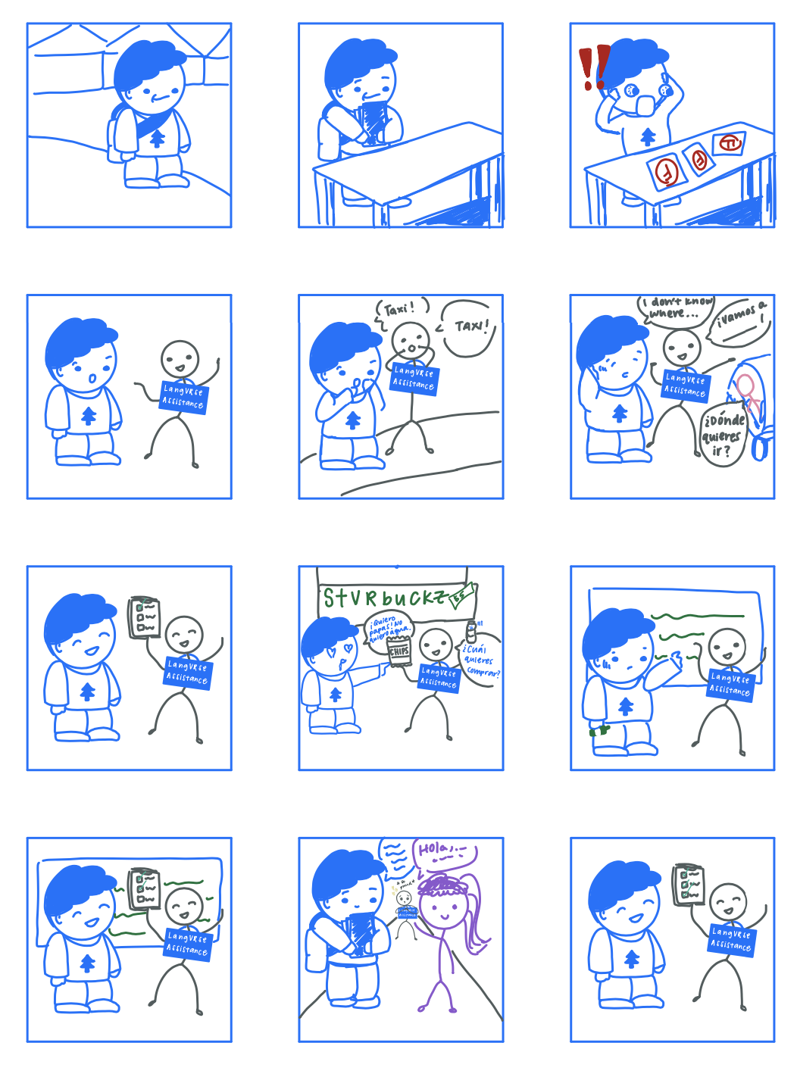
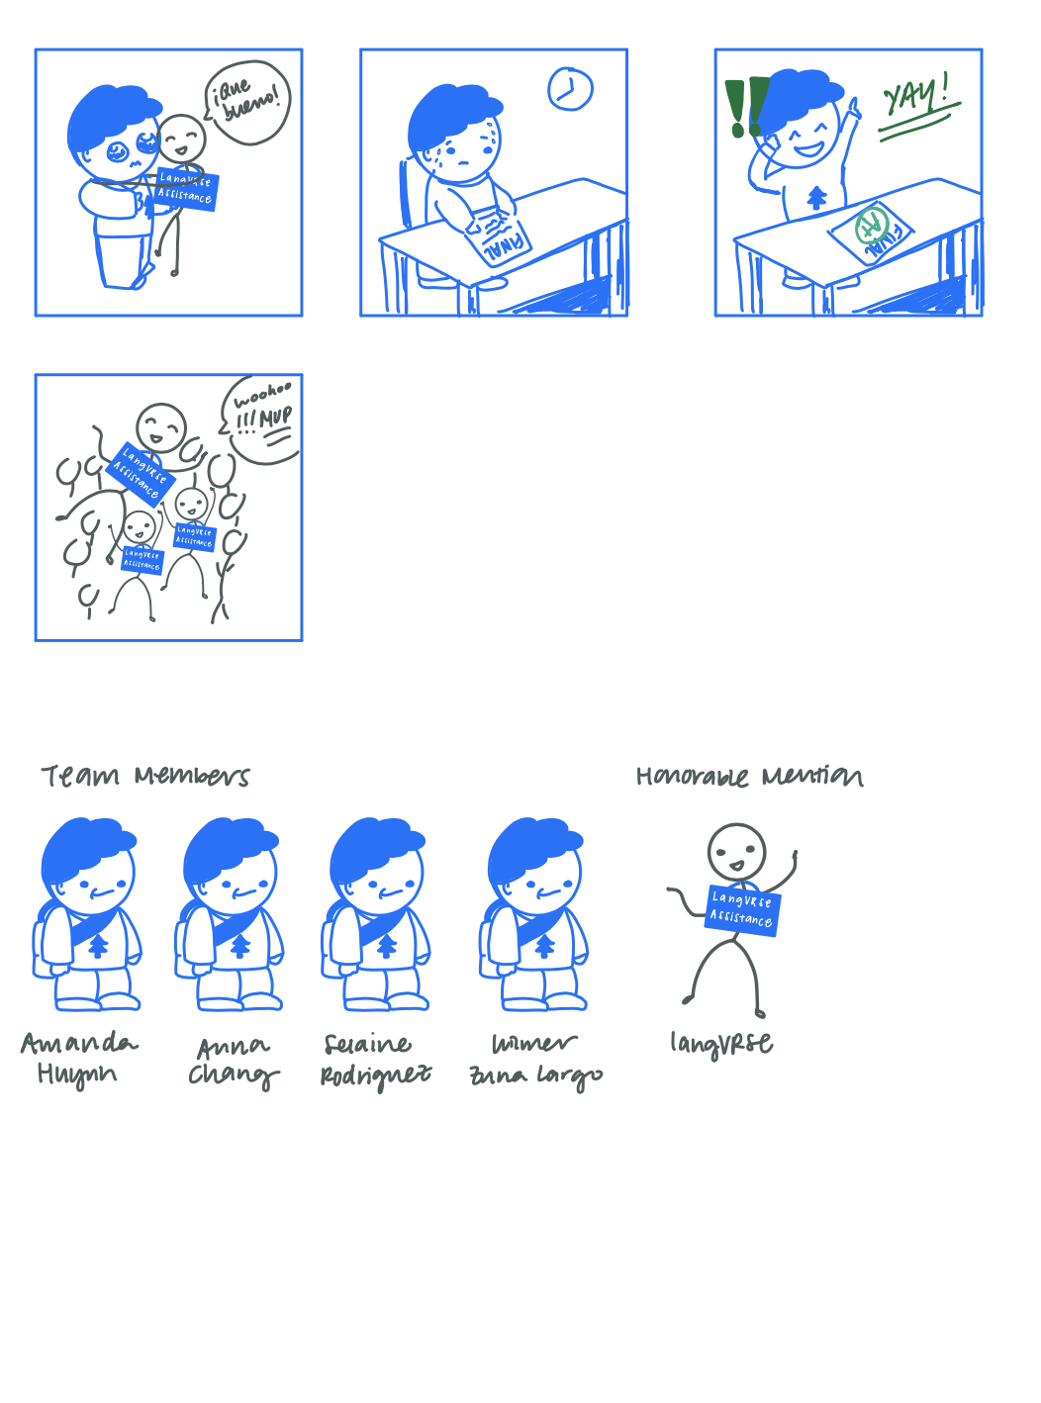
VIDEO STORYBOARD

Slide 15
Visual Storyboard now presented in text form on Slides 11 - 16 for accessibility reasons and increased ease of access.

Slide 16
VIDEO STORYBOARD
First Scene - Failing the Class
Location: Flexible?
Location Suggestions: Dorm, COHO/Starbucks, TAP
Idea:
Wilmer looks at a bunch of papers labeled “Spanish Test 1”, “Spanish Test 2”, “Spanish Test 3”, all labeled with a big red F.
Wilmer says something like “I’m totally going to fail the final, I wish I could understand Spanish now.” / “I’m totally going to fail this final, I wish I could just immerse myself in the language and learn this today.”
Selaine magically appears with a paper taped to her shirt that says “LangVRse Assistant”. Wilmer gets scared and tries to hide.
Selaine says something like “So you wanna understand Spanish? Let’s go test your skills.”
Pan over checklist with the different tasks, all not marked

Slide 17
VIDEO STORYBOARD
Second Scene - Ordering a Taxi
Location: Flexible?
Location Suggestions: Starbucks, Wilbur
Idea:
Wilmer hails a taxi
When asked where they are going, Wilmer is able to understand the question but not respond
Selaine helps him with requesting a ride
*Check off simple task 1: understand simple phrases on clipboard*

Slide 18
VIDEO STORYBOARD
Second Scene - Trying to Order Items in Spanish
Location: Starbucks? CoHo?
Idea:
Wilmer and Selaine walk up to the counter and sees all foods with a helpful Spanish translation
Selaine asks Wilmer what items he wants
Wilmer is able to point his likes and preferences, but not respond
Wilmer is able to write simple phrases in Spanish when asked
Selaine: “We still have a lot of work to do.”

Slide 19
VIDEO STORYBOARD
Third Scene - Training Montage Pt. 2
Location: Flexible (just need a board to write on)
Idea:
We try to test the second task of being able to introduce yourselves
We see Wilmer writing things down on a whiteboard, where he is able to show that he understands and can produce simple phrases
Wilmer hesitantly showing Selaine his answers, and they’re all correct -> more confident
Music buildup, Wilmer nervous, then Selaine checks off another thing from the list
Cue high five and a jump of happiness
*Checks off moderate task 2: be able to read, write, and produce common sentences on clipboard*

Slide 20
VIDEO STORYBOARD
Fourth Scene - Training Montage Pt. 2
Location: Flexible
Location Suggestions: Main Quad, Tresidder
Idea:
We see Wilmer hanging out on Main Quad with friends, holding a conversation in Spanish
Doesn’t need any help or results
Selaine looks from afar like a proud parent lmao , and crosses last thing off the list lol
*Checks off complex task 3: be able to hold a conversation with others on clipboard*

Slide 21
VIDEO STORYBOARD
Fifth Scene - Passing the Exam
Location: Flexible
Location Suggestions: Language Corner, somewhere with an empty room
Idea:
We see Wilmer walking into the testing room (door labeled Spanish final)
Skip to scene where Wilmer looks very nervous waiting for teacher to pass out exams
WIlmer walks out with a paper that has a green A on it & good improvement/good job (I know finals don’t really work like this but for view)
Wilmer leaves and sees friends from Fourth scene waiting and they skip into the sunset haha

Slide 22
06
CONCEPT VIDEO

Slide 23
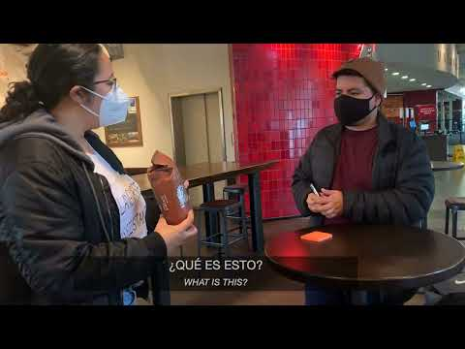

Slide 24

THANK YOU!
CREDITS: This presentation template was created by Slidesgo, including icons by Flaticon, infographics & images by Freepik.

